Slide 1
COMP 3132SEF / S313F
Lecture Notes
#7. React Native – Fundamentals
COMP 3132SEF / S313F - Lecture #7

Slide 2
Agenda
Introduction
React vs React Native
Prerequisites
React Native application development
Example – FirstApp
Basic concepts of React Native
COMP 3132SEF / S313F - Lecture #7

Slide 3
Introduction
Frameworks, like Cordova, provide the ability to develop apps using web-based technology, e.g., HTML, CSS and JavaScript
  You have the ability to make calls to native APIs (via plugins)
  But the bulk of your app will be HTML, CSS and JavaScript inside a native browser (the WebView)
React Native
  Run it in an embedded instance of "JavaScriptCore"
  Render to higher-level platform-specific components
COMP 3132SEF / S313F - Lecture #7

Slide 4
Introduction
React Native build mobile apps using JavaScript
It uses the same design as React, letting you compose a rich mobile UI from declarative components
With React Native, you don't build a mobile web app or an HTML5 app
  You build a real mobile app that's indistinguishable from an app built using Java/Kotlin (Android platform) or Swift/Objective-C (iOS platform)
React Native uses the same fundamental UI building blocks as regular Android and iOS apps
  You just put those building blocks together using JavaScript and React
COMP 3132SEF / S313F - Lecture #7

Slide 5
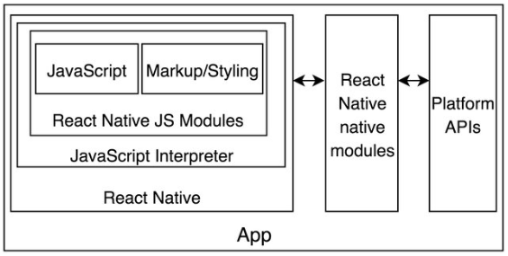
React Native
COMP 3132SEF / S313F - Lecture #7

Slide 6
React Native
JavaScript is required during the development
  No HTML and CSS
  => JavaScript-driven native
Provide the runtime "JavaScript Interpreter" (the JavaScriptCore) to interpret the written JavaScript
If a React Native app needs to access a native platform API that is not available by default in JavaScript, e.g., the native APIs to access Android or Apple pay
  It can call the platform APIs in real-time through the "React Native native modules"
  The "NativeModule" system exposes instances of native classes to "JavaScript" as JS objects, thereby allowing you to execute arbitrary native code from within JS
COMP 3132SEF / S313F - Lecture #7

Slide 7
React Native
MVC is a popular software architecture pattern for designing mobile applications
  Model
    The object that holds your application data and defines how to manipulate it
  View
    The objects that are in charge of the visual representation of the Model and the controls the user can interact with
  Controller
    The controller is the mediator that coordinates all the work
    E.g., it accesses the data from the model and displays it with the views, listens to events and manipulates the data as necessary
Advantage:
  It allows for efficient code reuse and parallel development by separating different concerns in the mobile application
COMP 3132SEF / S313F - Lecture #7

Slide 8
React Native – Advantages
JavaScript
  You can use the existing JavaScript knowledge to build native mobile apps
Native components
  React Native apps look, feel, and perform like other platforms specific apps
Code sharing
  You can share most of your code on different platforms
Community
  The community around React and React Native is large, and you will be able to find solution that you need
COMP 3132SEF / S313F - Lecture #7

Slide 9
React Native – Limitations
Native components
  Native functionality that you want to be employed in your application may not be available
    If so, you will need to write platform specific code
COMP 3132SEF / S313F - Lecture #7

Slide 10
React vs React Native
React (or call React.js)
  A JavaScript library which is responsible for building a hierarchy of UI components
    Responsible for the rendering of UI components
  Represent the View of the MVC (model-view-controller) framework
    i.e., a library for rendering your views
React Native
  Based on React
  A JavaScript framework for writing real, natively rendering Android and iOS applications
    i.e., React Native renders certain code components with native API’s
  Comes with Native Modules and Native components that improve performance
COMP 3132SEF / S313F - Lecture #7

Slide 11
React vs React Native
Conclusion
=> React is ideal for building dynamic, high performing, responsive UI for your web interfaces, while React Native is meant to give your mobile apps a truly native feel
React | React Native
Framework for building applications, e.g., web development, using JavaScript | Platform allowing you to build native, cross-platform mobile apps
Heart of React Native | Embodies all React's principles and syntax, so the learning curve is easy
COMP 3132SEF / S313F - Lecture #7

Slide 12
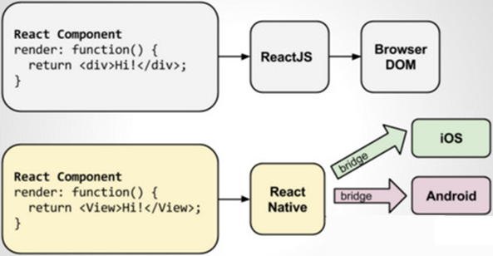
React vs React Native
Difference between ReactJS and React-Native
COMP 3132SEF / S313F - Lecture #7

Slide 13




React vs React Native
import React, { Component } from 'react'
import { Text, View, Button } from 'react-native’
// Class component
class CountClassReactNative extends Component {
state = {
count: 0
}
render() {
return (
<View>
<Text>
You clicked { this.state.count } times
</Text>
<Button
onPress={() =>
this.setState({ count: this.state.count + 1 })}
title="Click me!"
/>
</View>
)
}
}
export default CountClassReactNative;
import React, { Component } from 'react'
class CountClassReact extends Component {
state = {
count: 0
}
render() {
return (
<div>
<p>
You clicked { this.state.count } times
</p>
<button
onClick={() =>
this.setState({ count: this.state.count + 1 })}>
Click me!
</button>
</div>
)
}
}
export default CountClassReact;
COMP 3132SEF / S313F - Lecture #7

Slide 14
React Native – Prerequisites
You should have the following installed on your computer:
  (a) Node.js
  (b) SDK
    Android app development
      Android Studio and Android SDK
    iOS app development
      Xcode and iOS SDK
COMP 3132SEF / S313F - Lecture #7

Slide 15
React Native – Application Development
1. React Native project creation
2. Change to project directory
3. Execute the application
4. Application development
COMP 3132SEF / S313F - Lecture #7

Slide 16
1. React Native Project Creation
Command:
  npx react-native init <Project-Folder>
    <Project-Folder> represents the name of the folder going to be created
    It may take a few minutes to complete
Note:
  React Native has a built-in command line interface
  Rather than install and manage a specific version of the CLI globally, the current version at runtime using command "npx", which ships with Node.js, is accessed
  With the "npx react-native" command, the current stable version of the React Native CLI will be downloaded and executed at the time the command is run
COMP 3132SEF / S313F - Lecture #7

Slide 17
2. Change directory to the created project folder
Command:
  cd <Project-Folder>
    <Project-Folder> should be same as the one used in project creation
COMP 3132SEF / S313F - Lecture #7

Slide 18
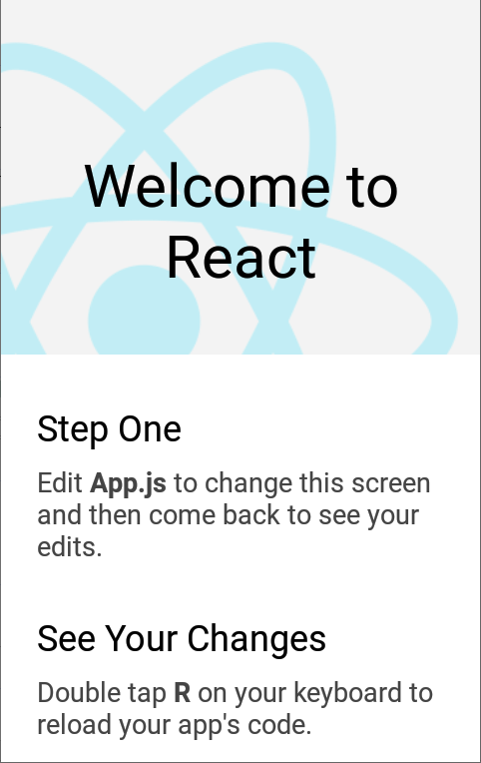
3. Execute the App
Command:
  npx react-native run-android
    It may take a few minutes to complete
After the command has been executed
  The .apk file for the app will be generated
If everything is set up correctly, you should see your new app running in your Android device/emulator
COMP 3132SEF / S313F - Lecture #7

Slide 19
4. Application development
Once you have successfully run the app, then it is time to modify it accordingly to the requirements
  Open the file "App.tsx" in your text editor of choice and edit it
Note:
  The changes will be automatically updated on the connected device/emulator once the file "App.tsx" is modified and saved
COMP 3132SEF / S313F - Lecture #7

Slide 20
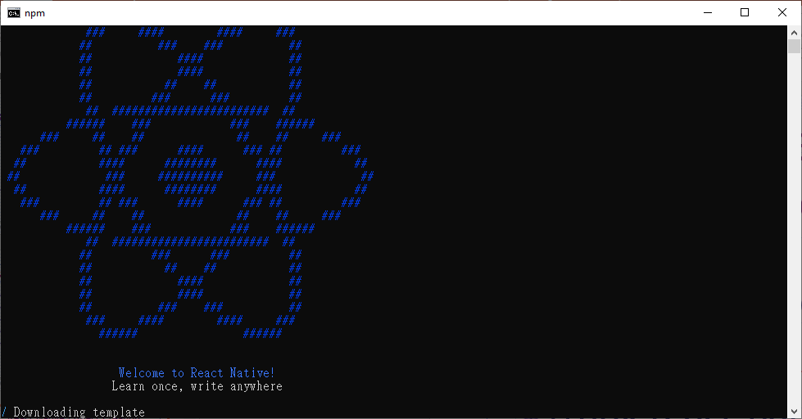
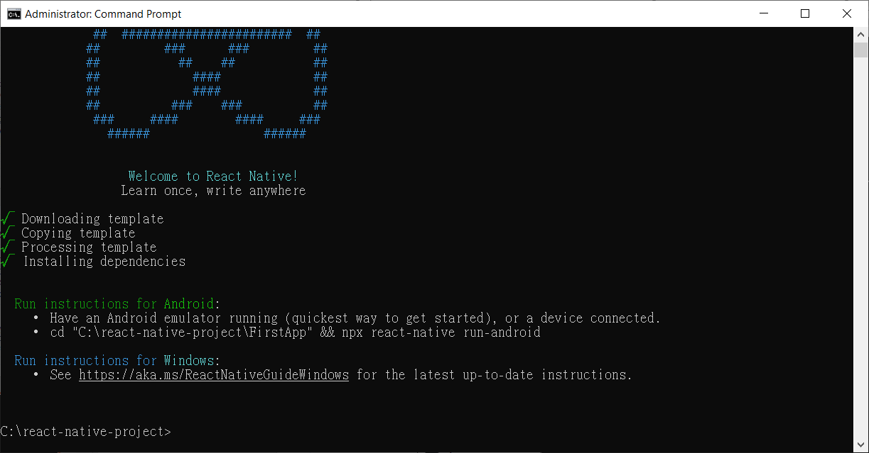
Example – FirstApp
1. Create a React-Native Project
  Command:
    npx react-native init FirstApp
      Folder "FirstApp" will be created
COMP 3132SEF / S313F - Lecture #7

Slide 21
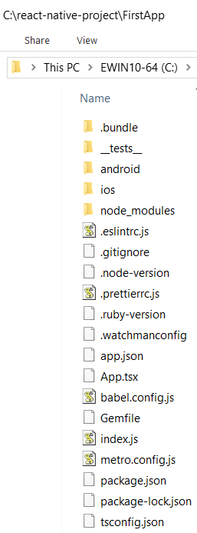
2. Change directory to the created project folder
Command:
  cd FirstApp
Project structure:
COMP 3132SEF / S313F - Lecture #7

Slide 22
2. Change directory to the created project folder
Folder:
  node_modules/
    Contains all the packages (or dependencies) that are used to develop and run this application
  android/
    Contains android related code to start this app for Android devices
  ios/
    Contains an Xcode project and the code to start this app for iOS devices
COMP 3132SEF / S313F - Lecture #7

Slide 23
2. Change directory to the created project folder
Files:
  App.tsx
    .tsx
      The TypeScript version of JSX (JavaScript XML)
      TypeScript is superset of JavaScript which allowing developers to add types
      JSX makes it easier to write and add HTML in React
        E.g., allows to write HTML elements in JavaScript
    The first file in any React Native app development
    It is the entry point of the app development process
    Whatever you write inside this file, it will be displayed on the mobile device
  index.js
    The entry point to trigger the app execution on a device or emulator
    It is the start point of the app
  package.json
    Contains information about the project
      E.g., name, version, and description
    Manage libraries, scripts, and project configurations
COMP 3132SEF / S313F - Lecture #7

Slide 24
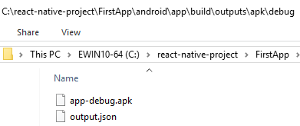
3. Execute the application
Command:
  npx react-native run-android
If everything is set up correctly, you should see the app running in your Android device/emulator
COMP 3132SEF / S313F - Lecture #7

Slide 25

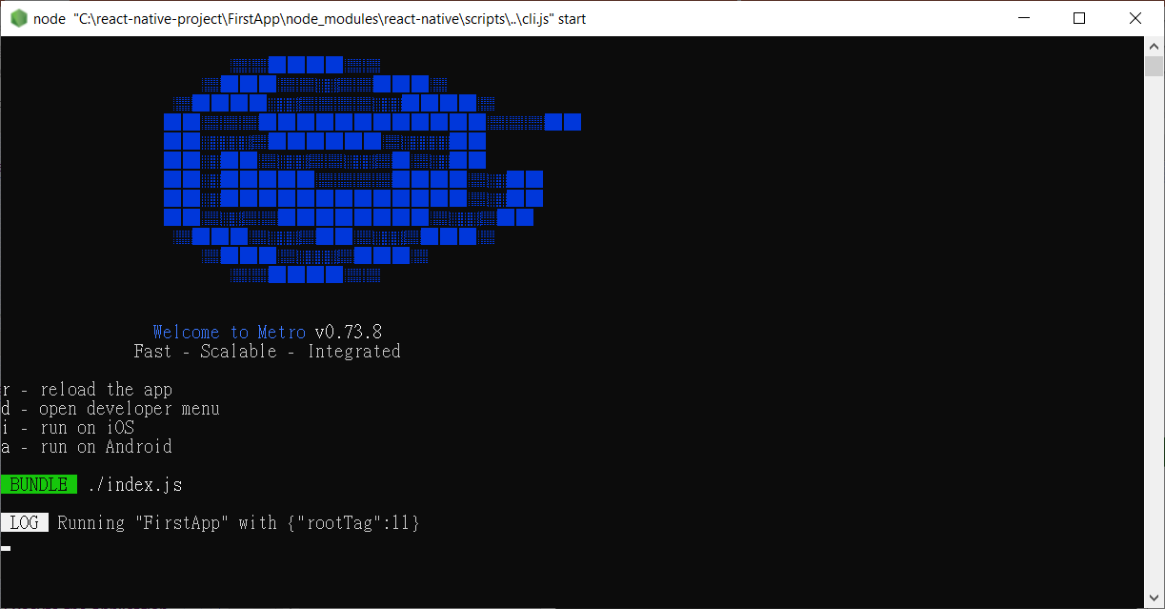
3. Execute the application
COMP 3132SEF / S313F - Lecture #7

Slide 26
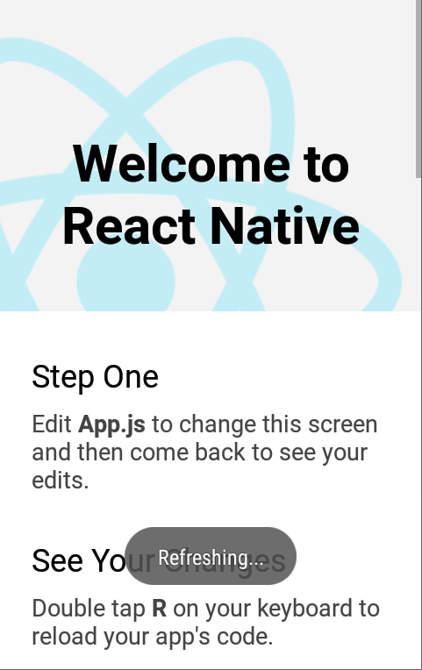

4. App Development
Modify the file "App.tsx"
  E.g.,
import React from 'react';
import { Text, View } from 'react-native';
// Function component
const FirstApp = () => {
return (
<View
style={{
flex: 1,
justifyContent: "center",
alignItems: "center"
}}>
<Text>Hello, world!</Text>
</View>
)
}
export default FirstApp;
COMP 3132SEF / S313F - Lecture #7

Slide 27
4. App Development
(1) Import "React", which will then be transformed to the native components of each platform
(2) Import the "Text" and "View" core components from "react-native"
(3) Define the "FirstApp" function
  i.e., a "function component"
  Behaves in the same way as in React for the web
  Returns a "View" component with a style and a "Text" as its child
Note:
  When building a React Native app, it always making lots of new components
  Anything you see on the screen is some sort of component
COMP 3132SEF / S313F - Lecture #7

Slide 28
4. App Development
style={{
flex: 1,
justifyContent: "center",
alignItems: "center"
}}
1st style: "flex: 1"
  The "flex" prop defines how the items are going to "fill" over the available space along your main axis (y-axis)
  In this case, it is the only component, so it will take all the available screen space
2nd style: "justifyContent: "center""
  This aligns children of a container, e.g., the "Text" component, in the center of the container's main axis (y-axis)
3rd style: "alignItems: "center""
  Align children of a container, e.g., the "Text" component, in the center of the container's cross axis (x-axis)
COMP 3132SEF / S313F - Lecture #7

Slide 29
4. App Development
...
<View ...>
<Text>Hello world!</Text>
</View>
...
This is JSX
  A syntax for embedding XML within JavaScript
  JSX allows you to write your markup language inside code
Instead of web elements, such as <div> or <span>, React components are used, e.g.,
  <View>
    Like the <div> or <span>
  <Text>
    Core component that displays text
COMP 3132SEF / S313F - Lecture #7

Slide 30
Example – FirstApp
Summary of used commands:
  npx react-native init FirstApp
  cd FirstApp
  npx react-native run-android
COMP 3132SEF / S313F - Lecture #7

Slide 31
Basic Concepts of React Native
1. Components
  (a) Function/stateless components
  (b) Class/stateful components
2. Props
3. State
COMP 3132SEF / S313F - Lecture #7

Slide 32
1. Components
React/React Native is based on a component architecture
A component represents the part of user interface
  Obtain data from data source for display
  Support different style
i.e., every UI element is a component which can be styled and backed by a data source
Components are reusable and can be used in anywhere in user interface
Two main components:
  (a) Function component (or Stateless component)
  (b) Class component (or Stateful component)
COMP 3132SEF / S313F - Lecture #7

Slide 33
(a) Function/Stateless Components
It is JavaScript functions that returns UI
It is also called "stateless components" because they simply
  (i) accept data, and
  (ii) display them
Note:
  It accept properties ("props") in function and return markup script (JSX)
  There is no "render" method used in function components
  It gives solution without using "state"
COMP 3132SEF / S313F - Lecture #7

Slide 34
(a) Function/Stateless Components
Function components can be defined using
  (i) Arrow functions ( => ), or
  (ii) "function" keyword
import React from 'react';
import { Text, View } from 'react-native';
const Courses1 = () => { // (i)
// No render() method
return (
<View>
<Text>Course: COMP 3132SEF</Text>
</View>
);
}
export default Courses1;
import React from 'react';
import { Text, View } from 'react-native';
function Courses2() { // (ii)
// No render() method
return (
<View>
<Text>Course: COMP 3132SEF</Text>
</View>
);
}
export default Courses2;
COMP 3132SEF / S313F - Lecture #7

Slide 35
(a) Function/Stateless Components
You can think of components as blueprints
  Whatever a function component returns, it is rendered as a React element
  The React elements represent what you want to see on the screen
E.g., the "Courses1" and "Courses2" components will render a "<View>" and a "<Text>" element
  <View>
    Renders a "UIView" for iOS and "View" for Android
  <Text>
    Renders a "UILabel" for iOS and "TextView" for Android
You can export your function component with JavaScript’s "export default" for rendering
COMP 3132SEF / S313F - Lecture #7

Slide 36

(a) Function/Stateless Components
React allows you to nest components inside each other to create new components
These nestable, reusable components are the heart of the React paradigm
E.g., you can nest two "Text"s inside a "View", and React Native will render them together
  "View" component is useful as a container for other components
    E.g., to help control style and layout
import React from 'react';
import { Text, View } from 'react-native';
const Courses = () => {
return (
<View>
<Text>Course: COMP 3132SEF</Text>
<Text>Course: COMP S313F</Text>
</View>
);
}
export default Courses;
COMP 3132SEF / S313F - Lecture #7

Slide 37
(b) Class/Stateful Component
Also called "stateful components" because they support
  "State" implementation
    "State" will be discussed in later section
It must have "render()" method for returning the UI
COMP 3132SEF / S313F - Lecture #7

Slide 38
(b) Class/Stateful Component
Classes that extends "component" class from the "react" library
import React, { Component } from 'react';
import { View, Text } from 'react-native';
class Courses extends Component {
// Must have "render()" method
render() {
return (
<View>
<Text>Course: COMP 3132SEF</Text>
</View>
);
}
}
export default Courses;
COMP 3132SEF / S313F - Lecture #7

Slide 39
2. Props
Short for "Properties"
Most components can be customized with different parameters when they are created
  These creation parameters are called "props"
Components receive props from their parent
  These props should NOT be modified inside the component
  i.e., the data flows in one direction
    => From parent component to child component
You can write your own components that use props
  The idea behind props is that you can make a single component that can be used in different places in your app
    i.e., different parents in different places can call the child component which can set different properties
COMP 3132SEF / S313F - Lecture #7

Slide 40
2. Props – Example 1
Props
  "courseCode"
Components
  "Course"
    Child component
    Received props "courseCode" from parent
  "Courses"
    Parent component
    Pass props "courseCode" to child
import React from 'react';
import { Text, View } from 'react-native';
const Course = (props) => {
return (
<View>
<Text>Course: { props.courseCode }</Text>
</View>
);
}
const Courses = () => {
return (
<View>
<Course courseCode='COMP 3132SEF' />
<Course courseCode='COMP S313F' />
</View>
);
}
export default Courses;
COMP 3132SEF / S313F - Lecture #7

Slide 41
2. Props – Example 1
Using "courseCode" as a prop can customize the "Course" component
So that the "Course" component can be reused to represent different courses
COMP 3132SEF / S313F - Lecture #7

Slide 42

2. Props – Example 2
UI widget "Text" component includes props such as "style"
import React from 'react';
import { Text, View } from 'react-native';
const Courses = () => {
return (
<View >
<Text style={{
fontSize: 20,
fontWeight: "bold"
}}>
Course: COMP 3132SEF
</Text>
</View>
);
}
export default Courses;
COMP 3132SEF / S313F - Lecture #7

Slide 43
2. Props
Conclusion
  With props, UI components such as "Text", "Image", and "View" components, a wide variety of static screens can be built
  However, to make the app change over time (dynamically), you need to use "State"
COMP 3132SEF / S313F - Lecture #7

Slide 44
3. State
There are two types of data that control a component:
  Props
    Props are set by the parent and they are fixed throughout the lifetime of a component
  State
    For data that is able to be modified, we have to use state
When can state be used?
  Whenever there is data that should support dynamically change within a component during the lifetime of the app, state can be used
COMP 3132SEF / S313F - Lecture #7

Slide 45
3. State – Example
import React, { Component } from 'react'
import { Text, View, Button } from 'react-native'
class CountClass extends Component {
state = {
count: 0
}
buttonPress = () => {
this.setState({
count: this.state.count + 1
})
}
render() {
return (
<View>
<Text>
You clicked { this.state.count } times
</Text>
<Button
onPress = { this.buttonPress }
// Or simply update the count without using the function buttonPress
// onPress={() => this.setState({ count: this.state.count + 1 })}
title="CLICK ME!"
/>
</View>
)
}
}
export default CountClass;
Button clicked
COMP 3132SEF / S313F - Lecture #7

Slide 46
3. State – Example
"{ count: 0 }"
  The initialization of the state "count" to zero (0)
"buttonPress" function
  Increment the state "count" by 1 (i.e., count = count + 1)
"this.state.count"
  Represents the current value of the state "count"
  E.g., used to update the value of the state "count" and label of "Text" dynamically
"onPress = { this.buttonPress }"
  When the user clicks the button, method "buttonPress" will be called
  Then the "this.setState" function will be invoked
  So that the "state.count" will be updated
  Finally, the content of the "Text" also be changed accordingly
COMP 3132SEF / S313F - Lecture #7

Slide 47
Props vs State
Props
  Variables
  Values pass from a parent component to a child component
  Read-only (i.e., value should not be modified)
State
  Also variables
  Values not passed as parameters
    Initialized and managed by component internally
  Allow to be changed by component in response to user actions, network responses, …, etc.
COMP 3132SEF / S313F - Lecture #7

